Slide 1
Image Processing Using Python
for
III B.Tech (CSM & AIML) - I Semester
By
T. Vijaya Kumar
Assistant Professor
Dept. of ECE, VVIT

Slide 2
Syllabus
UNIT – IV

Slide 3
Morphology
Morphology: a branch of biology that deals with the form and structure of animals and plants
Morphological image processing is used to extract image components for representation and description of region shape, such as boundaries, skeletons, and the convex hull

Slide 4
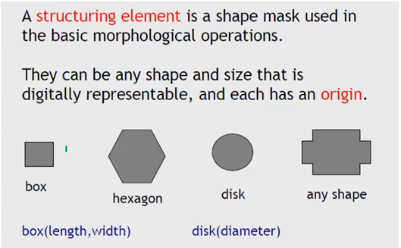
Preliminaries
Structure elements (SE): Small sets or sub-images used to probe an image under study for properties of interest
Examples:

Slide 5
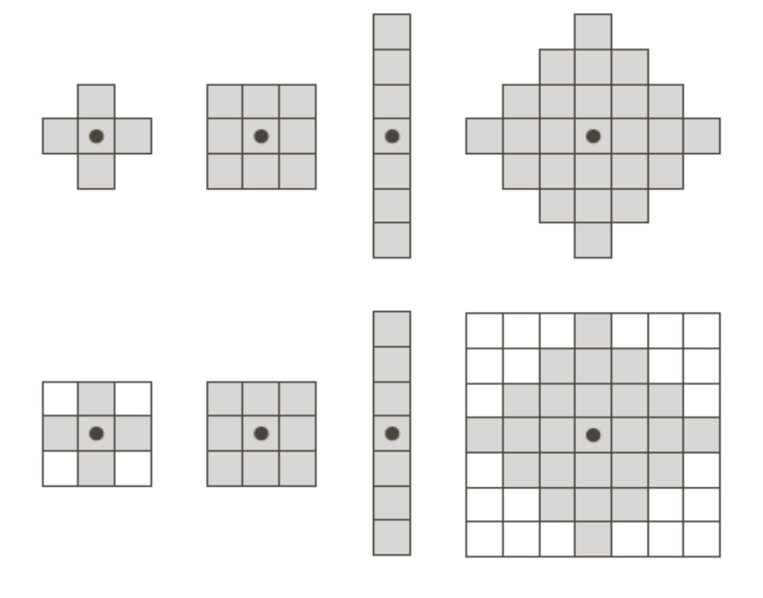
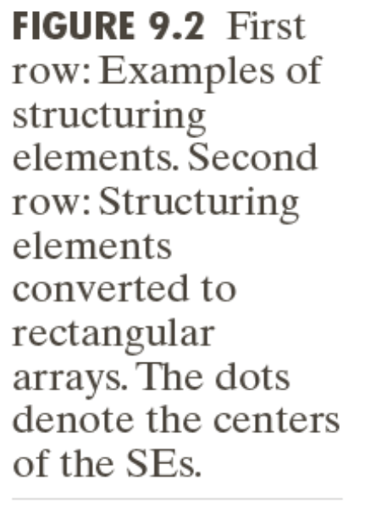
Preliminaries
Structure elements (SE): Small sets or sub-images used to probe an image under study for properties of interest
Examples:
origin

Slide 6
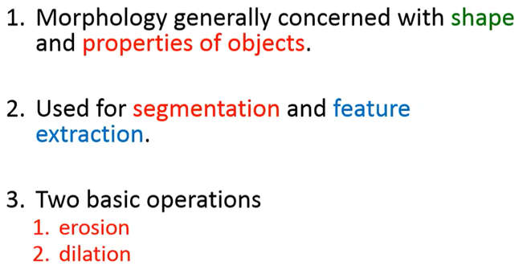
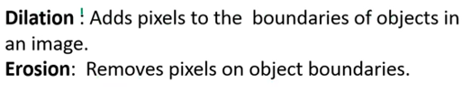
Morphology

Slide 7
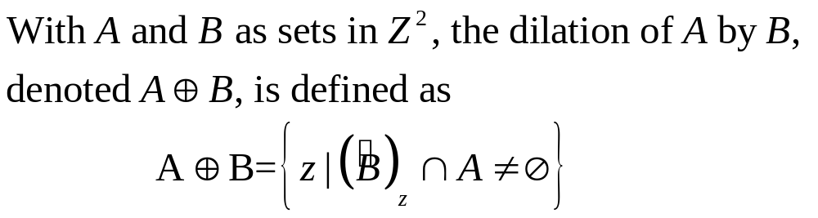
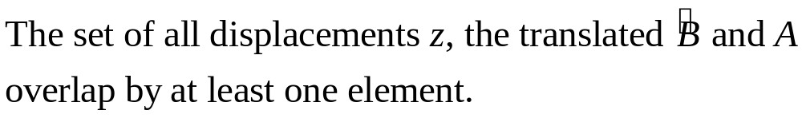

Dilation

Slide 8
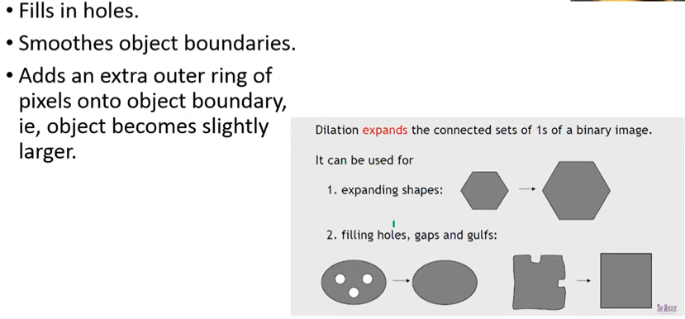

Dilation

Slide 9
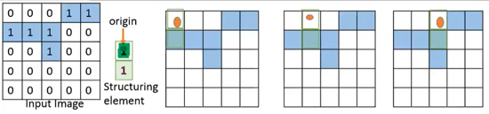
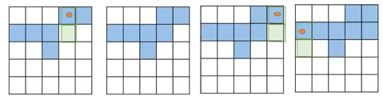
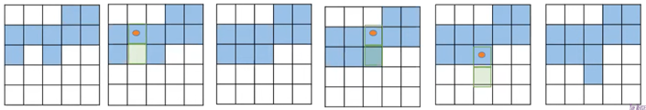
Dilation

Slide 10

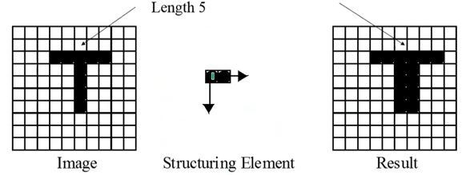
Dilation

Slide 11
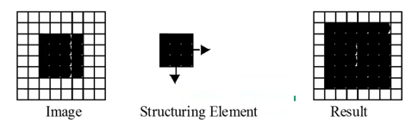
Dilation

Slide 12
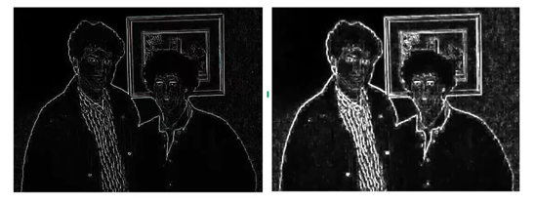
Dilation

Slide 13
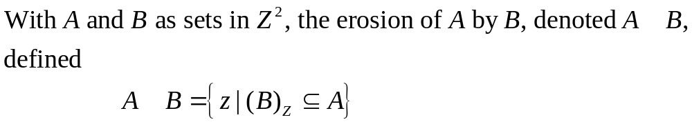
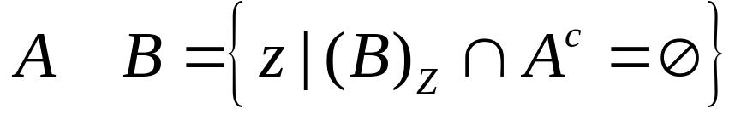
Erosion

Slide 14
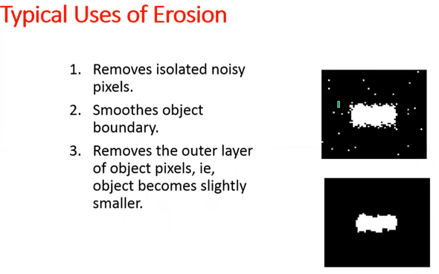
Erosion

Slide 15
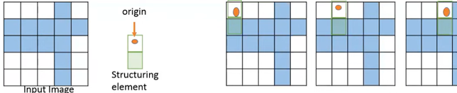

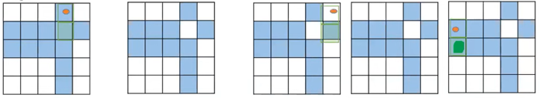
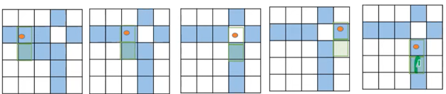
Erosion

Slide 16

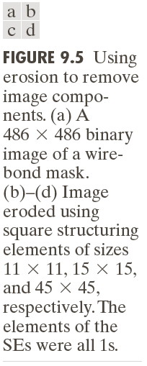
Example of Erosion

Slide 17

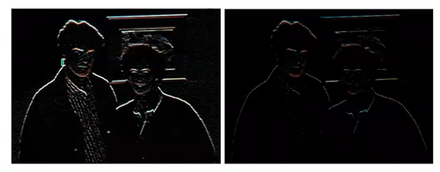

Slide 18
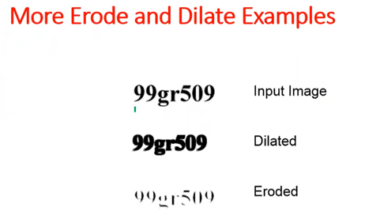

Slide 19
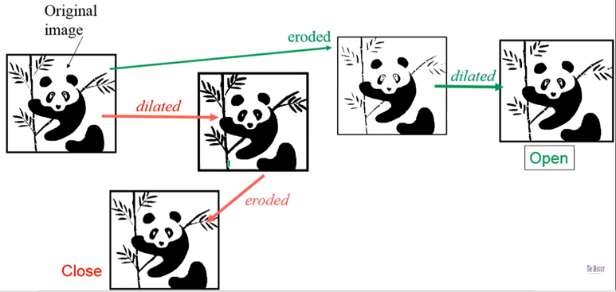
Open and Close

Slide 20
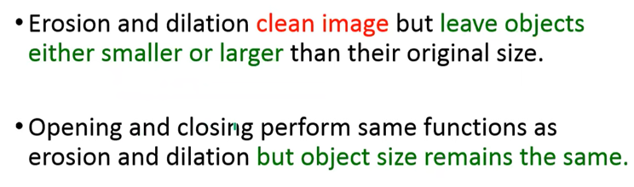
Difference

